Slide 1

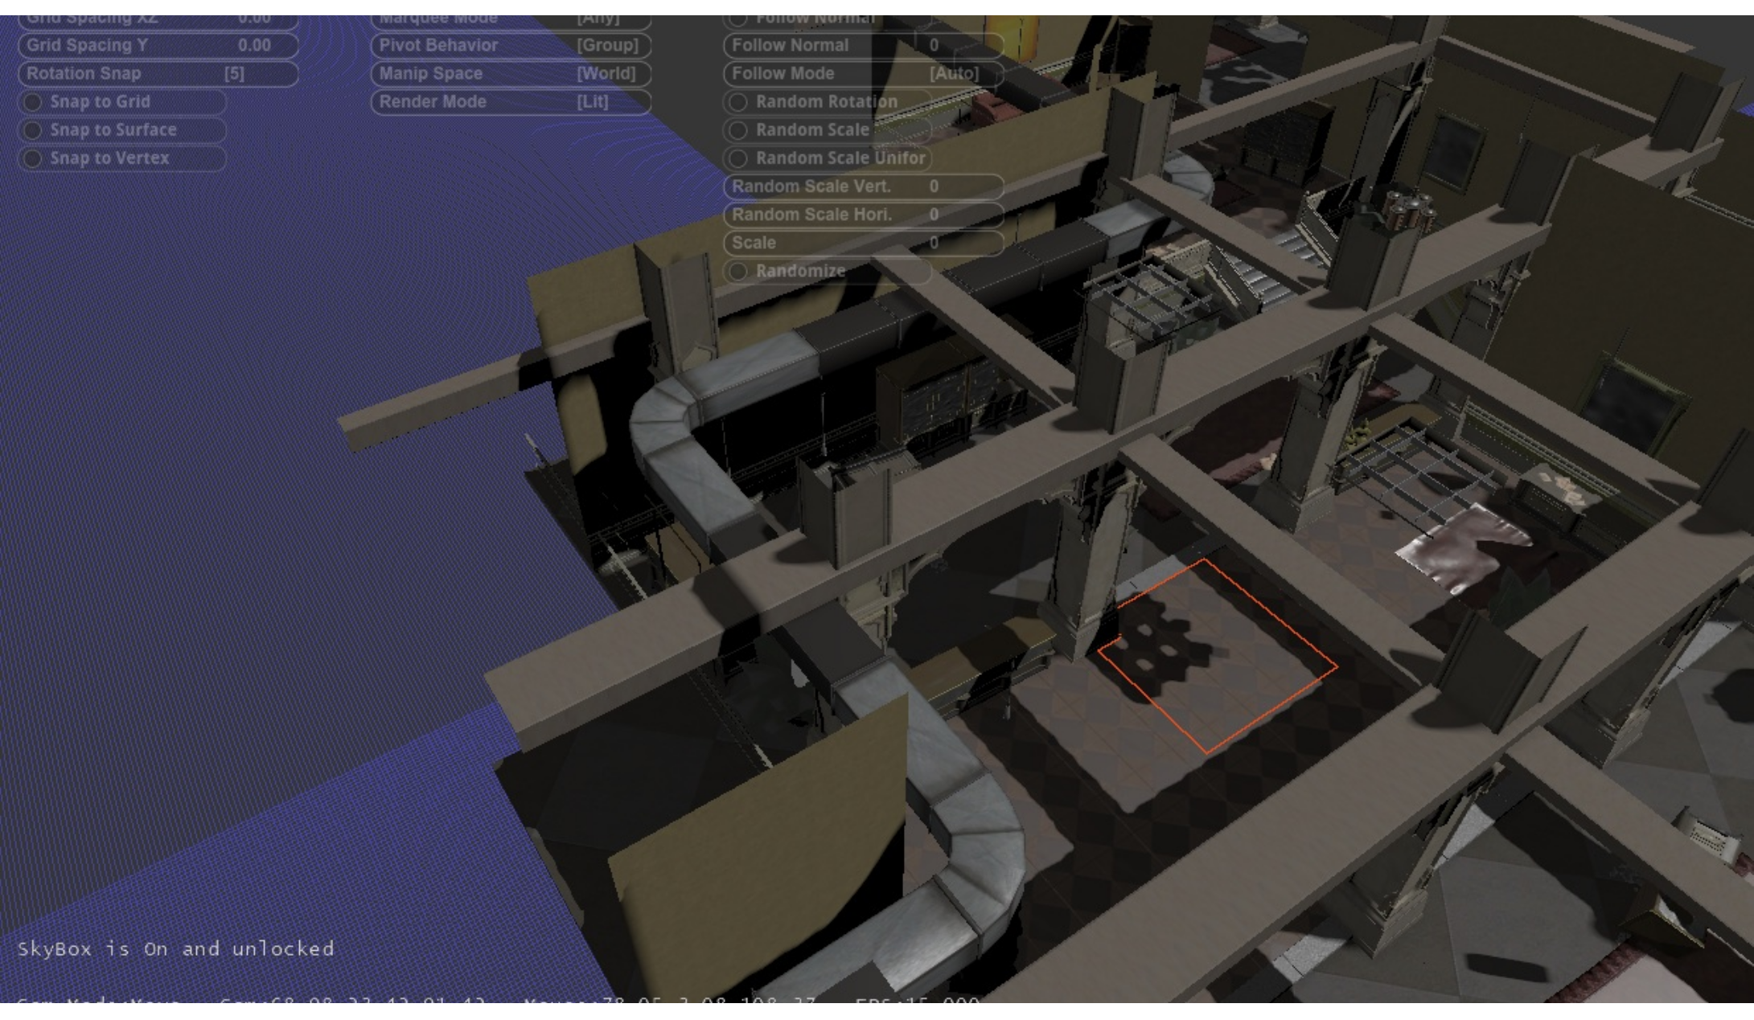
INSOMNIAC TOOLS
2011

Slide 2
MEANING
PROGRESS
REFLECTION

Slide 3
MEANING

Slide 4
EVERYTHING
REFLECTS
CREATIVE VISION

Slide 5
PS3

Slide 6
GTC
REGISTRATION
LINE

Slide 7
START
WITH
A VISION

Slide 8
REALTIME

Slide 9
DYNAMIC
FUNCTION
ONLY
IN
GAMES

Slide 10
THE
ZEITGEIST

Slide 11
CONSTANT
FEEDBACK

Slide 12
STORYTELLING

Slide 13
NOT
ITERATION,
CREATIVE
EXPRESSION

Slide 14
ART VS
ADVERTISEMENT

Slide 15
ENGINE
ECONOMICS
(COMMODITY)

Slide 16
BEYOND THE
BULLET
POINT

Slide 17
UX

Slide 18
PROGRESS

Slide 19
THREE
CONTROVERSIAL
CHOICES...

Slide 20
MERGED
RULES

Slide 21
FLASH

Slide 22
WEBAPP

Slide 23
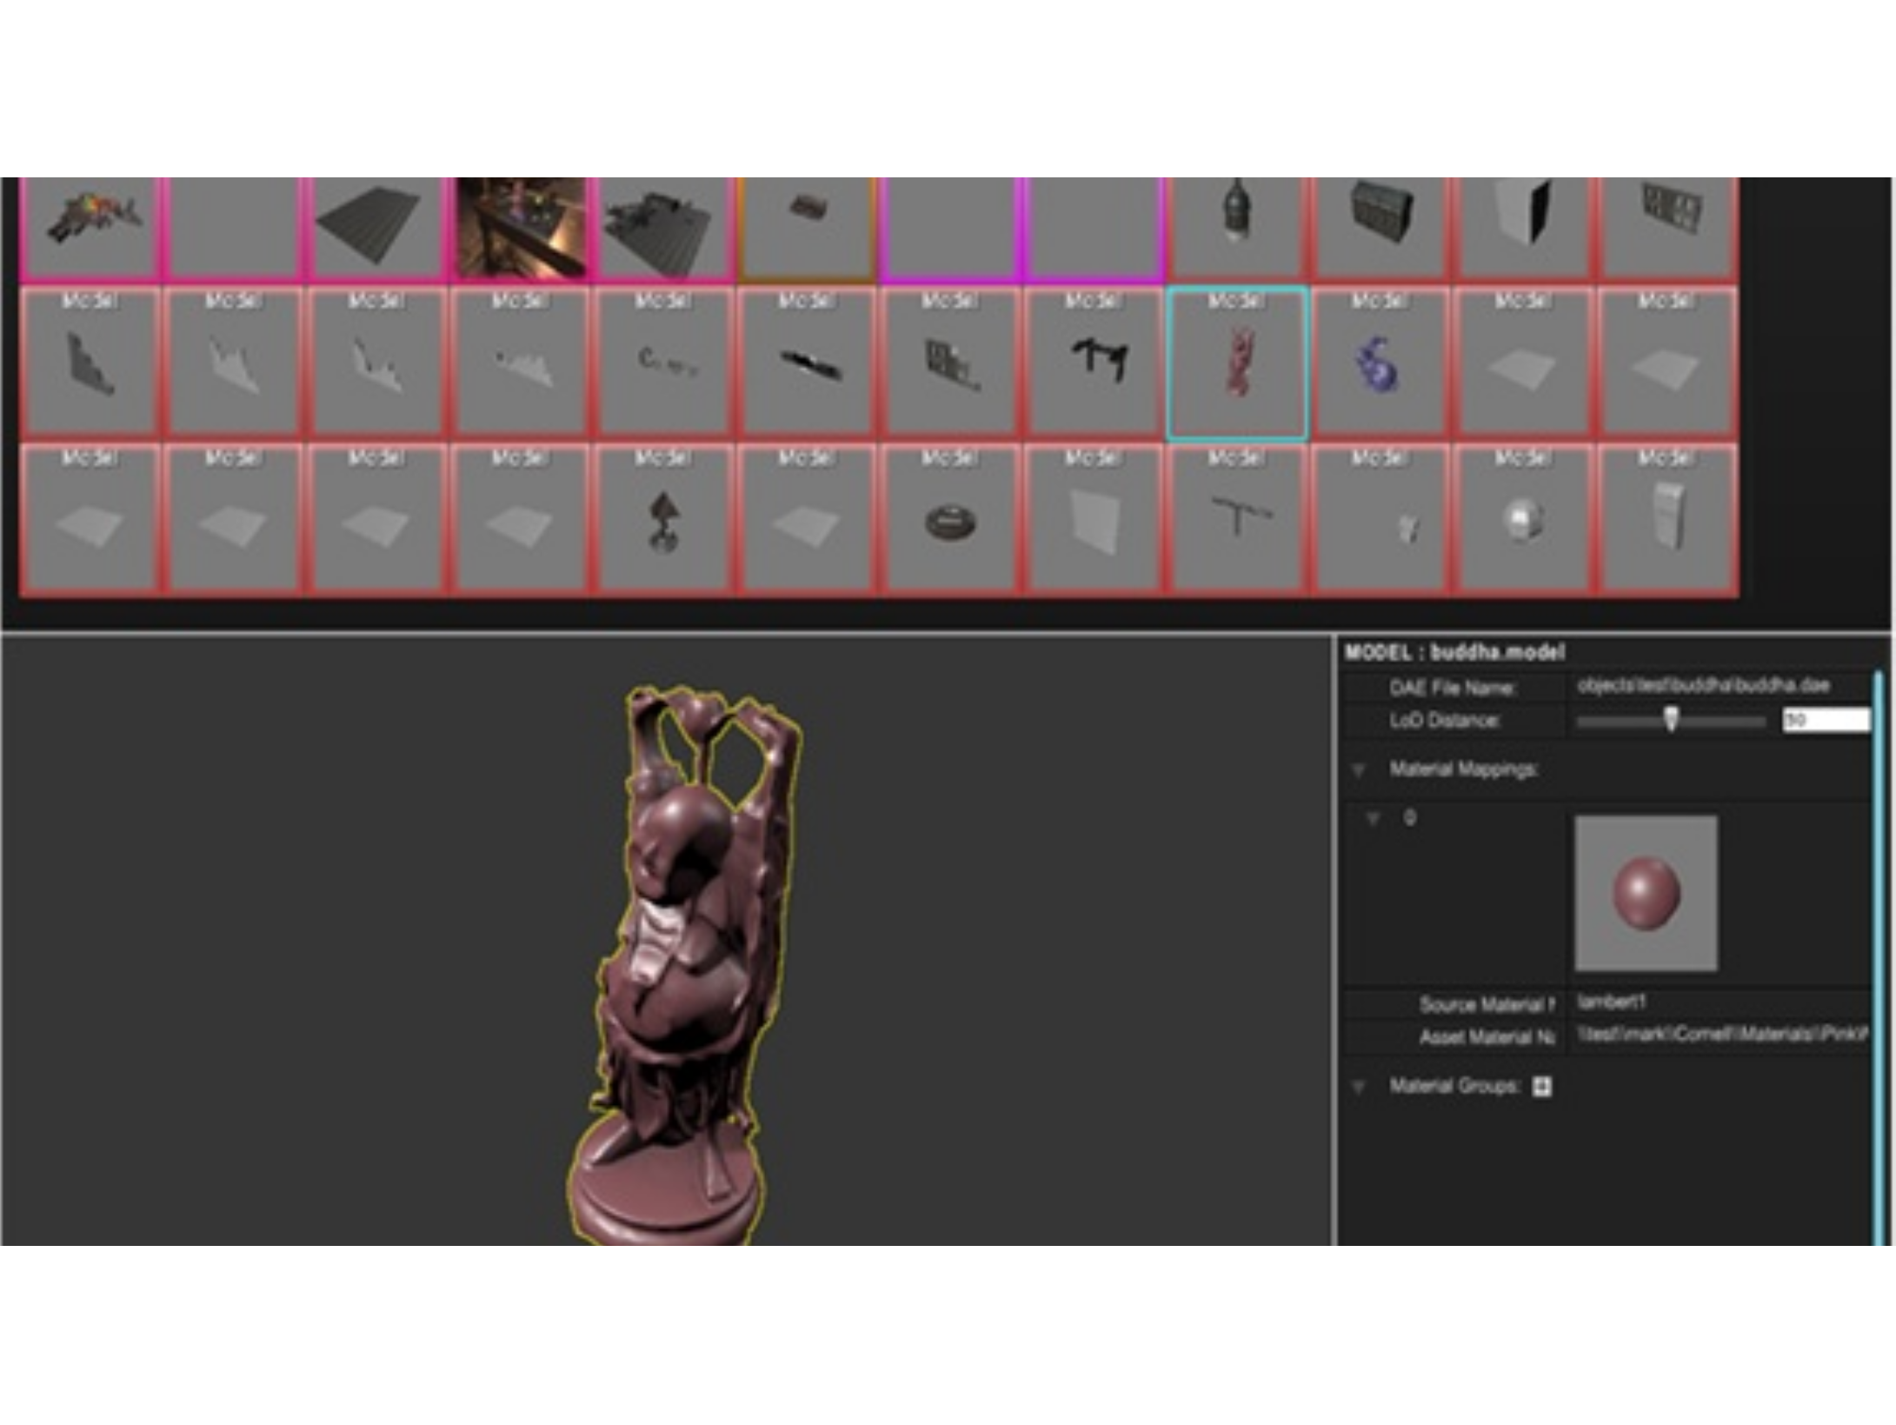
JUMP
IN
AND
EDIT

Slide 24
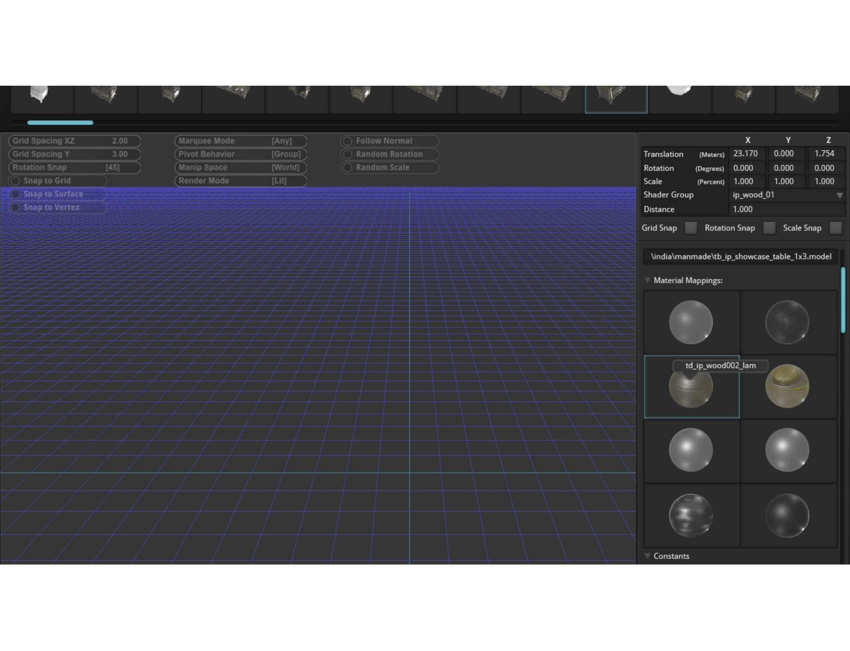

Slide 25
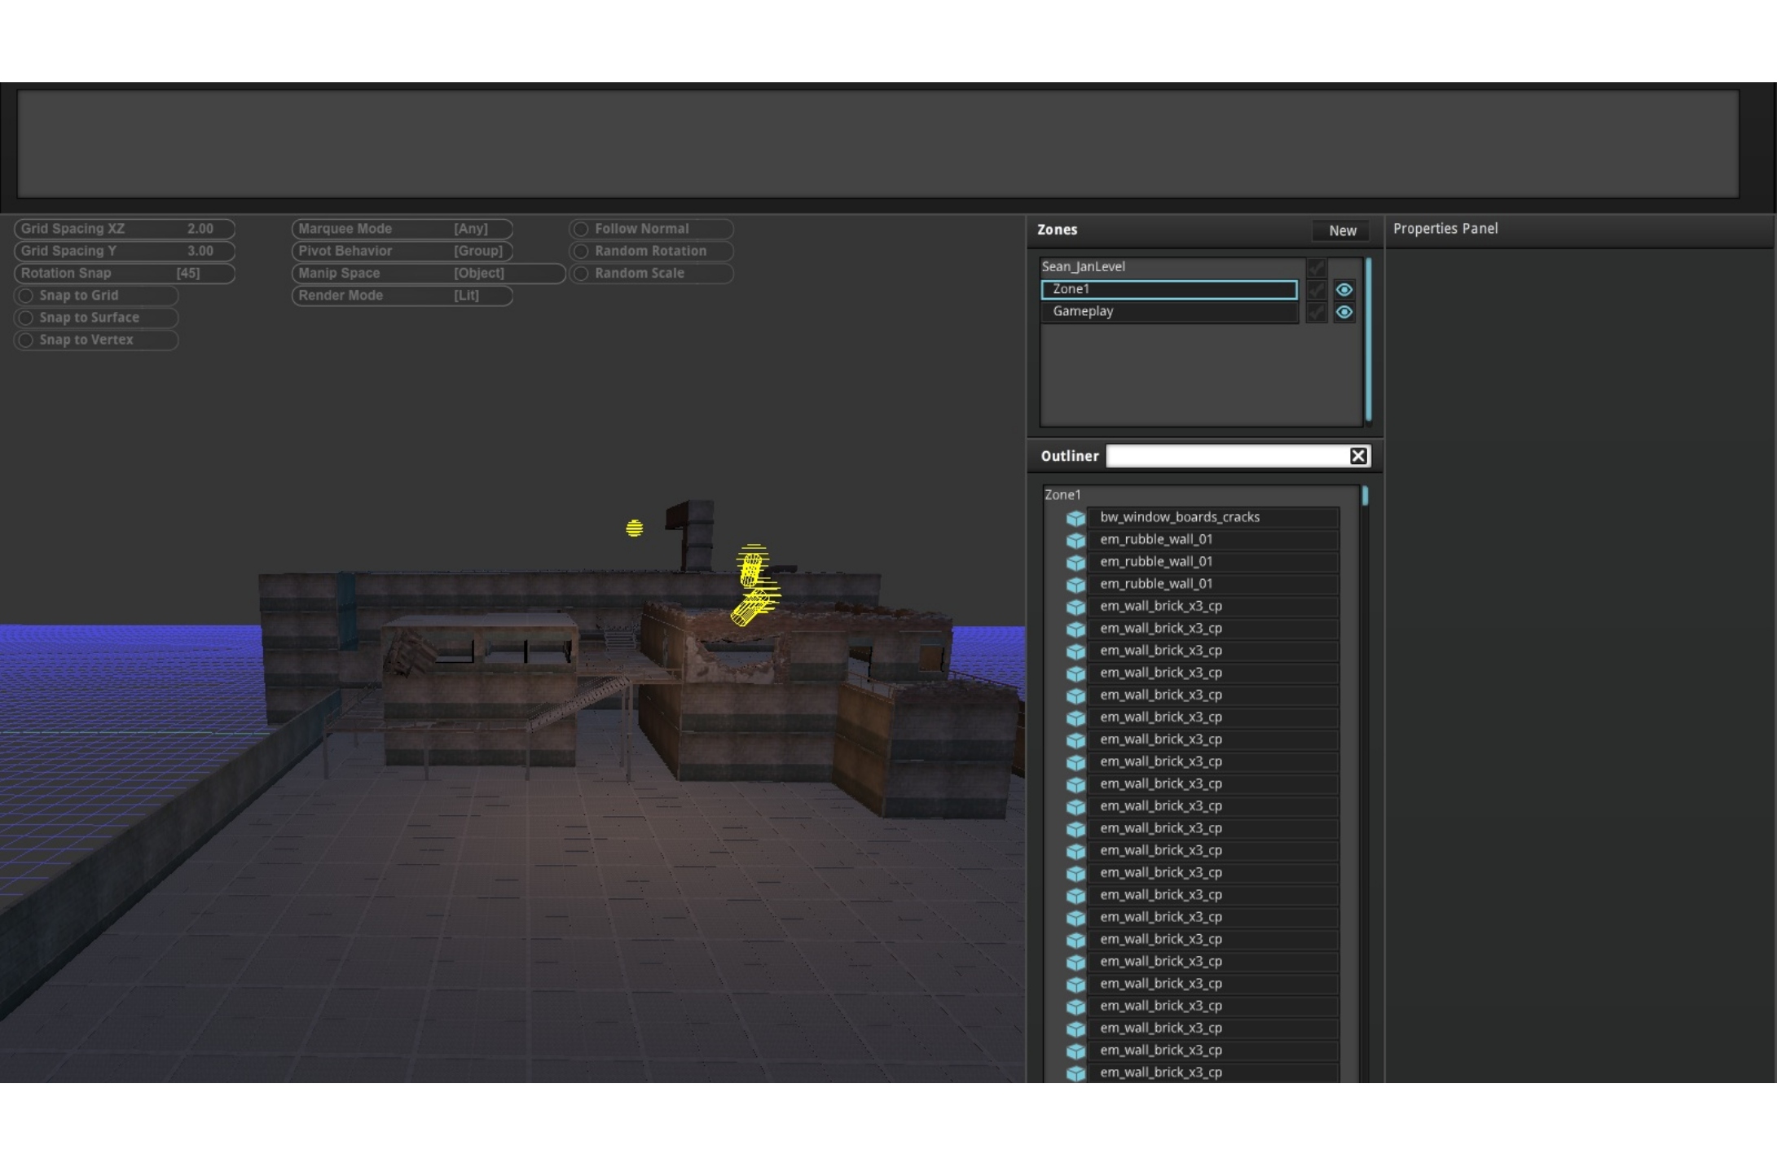
PANEL
DESIGN

Slide 26
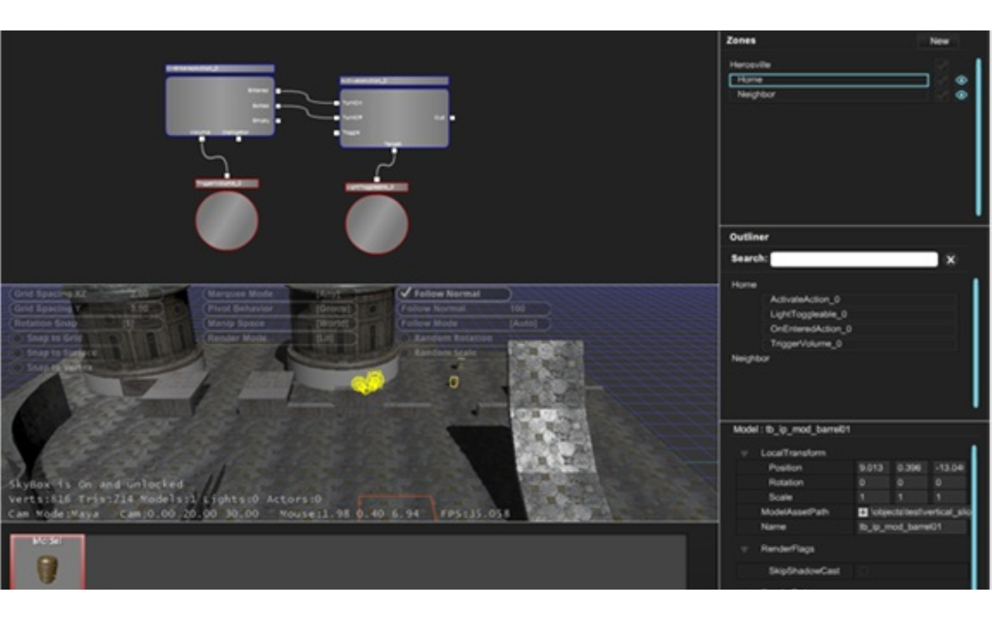
LIVE
EDIT
AND VIEW

Slide 27
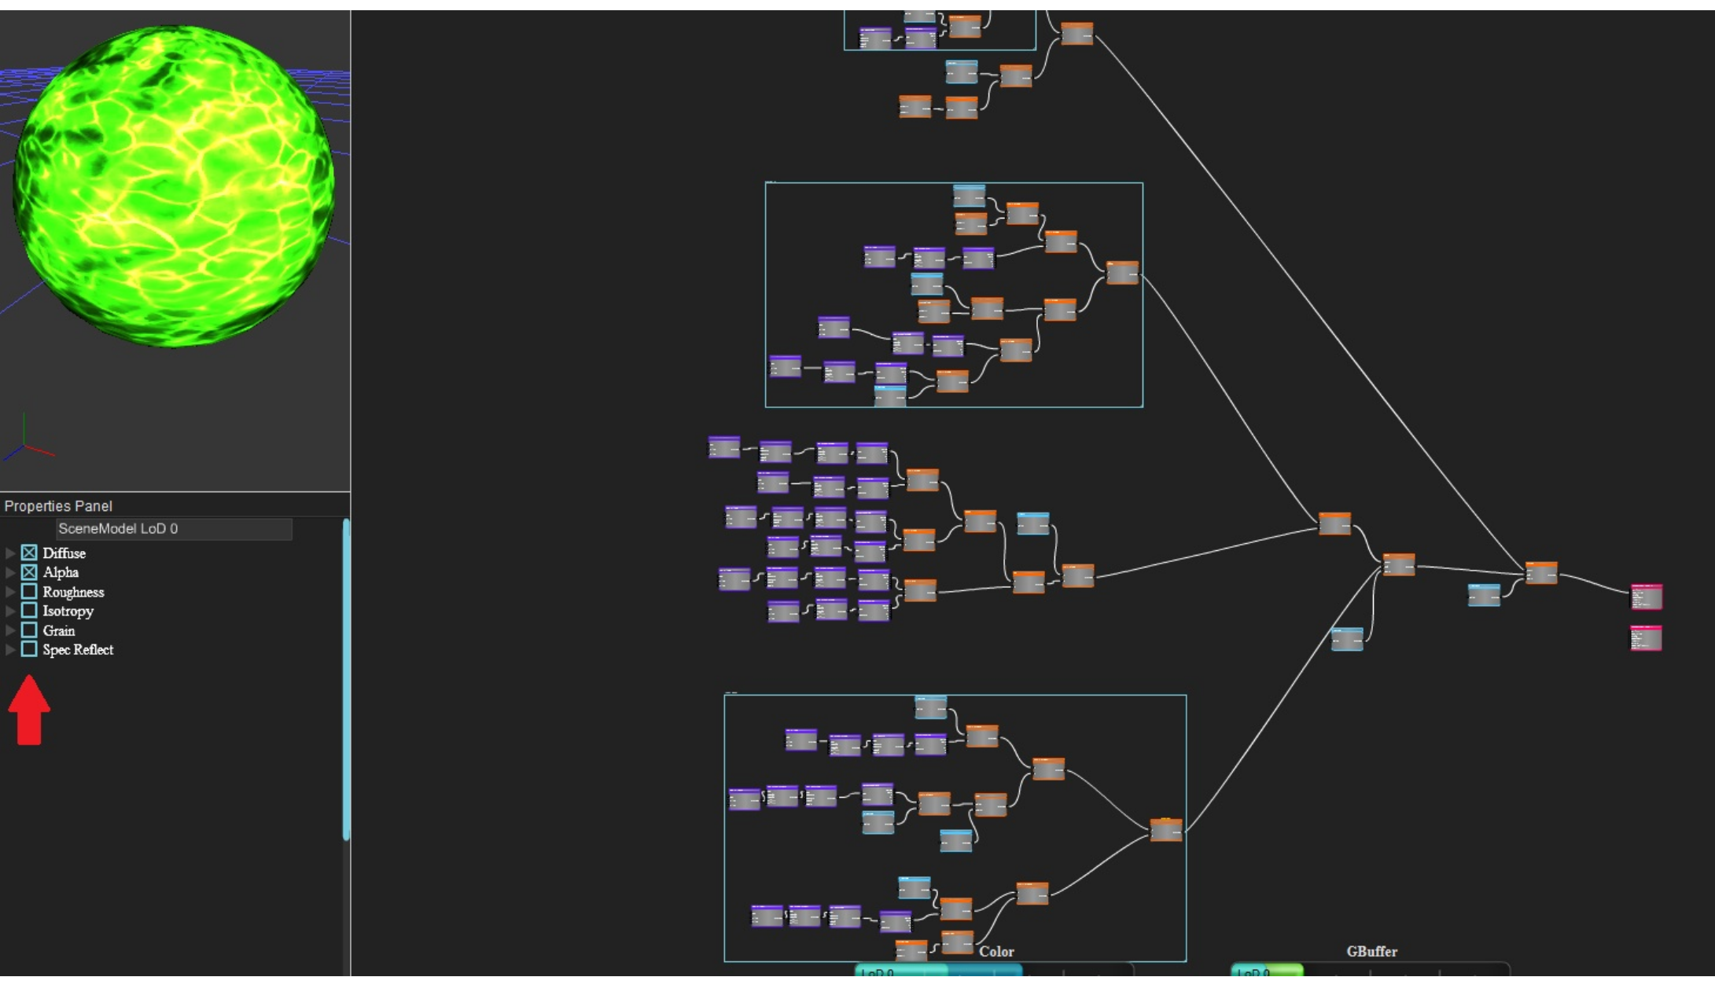

Slide 29
LUNASERVER

Slide 30
SINGLE
MONITOR

Slide 31
MOUSE VS
KEYBOARD

Slide 32
REFLECTION

Slide 33
TEAM
CULTURE
SHIFT

Slide 34
FEEDBACK

Slide 35
OPEN
HOUSE

Slide 36
USABILITY

Slide 37
PROJECT
GROUPS

Slide 38
LESSONS...

Slide 39
FEAR
OF
CHANGE

Slide 40
MORE
FEATURES,
CONTROLS

Slide 41
DESIGN
CRUTCHES

Slide 42
DISCOVERABILITY

Slide 43
"IN
PLAIN
ENGLISH"

Slide 44
FIVE-SECOND
RULE

Slide 45
"FAILURE
IS
NOT
BAD"

Slide 46
TOOLS
REFLECT
STUDIO
CULTURE

Slide 47
LEADERSHIP

Slide 48
TRUST

Slide 49
COMPROMISES

Slide 50
MATCH VISION
WITH
GAME
PRODUCTIONS

Slide 51
GAMIFICATION

Slide 52
MEANING
PROGRESS
REFLECTION

Slide 53
DREAM

